Slide 1
October 17, 2018

Slide 2
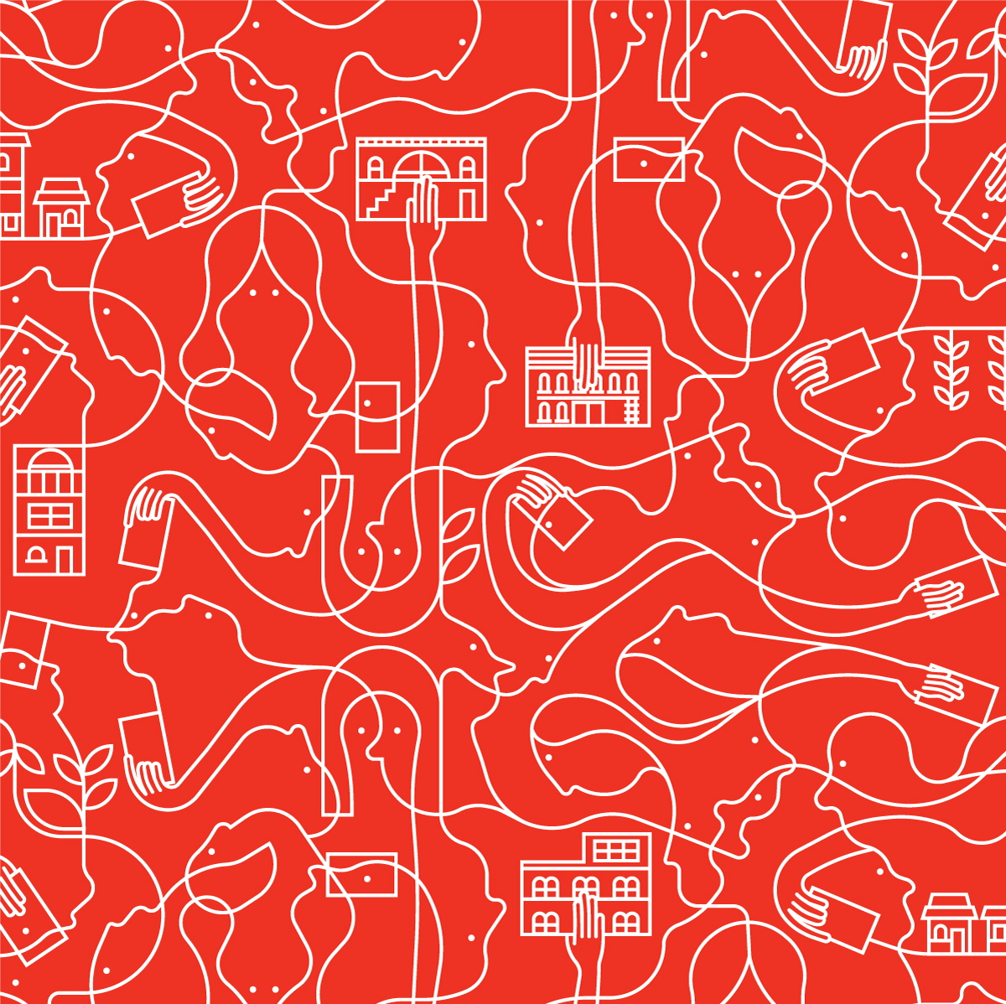


What are Community Bonds?
A proven social finance tool
Issued by co-operative and non-profit organizations
An interest bearing loan from community members
Used to finance a capital project
Typically 20-30% of total project cost
Done properly, can be held in RRSP or TFSA
Notes:
Explain exemption of the Ontario Securities commission
Much less complex process than a for-profit company would have to undertake to issue securities
Can explain how they differ from preffered shares

Slide 3
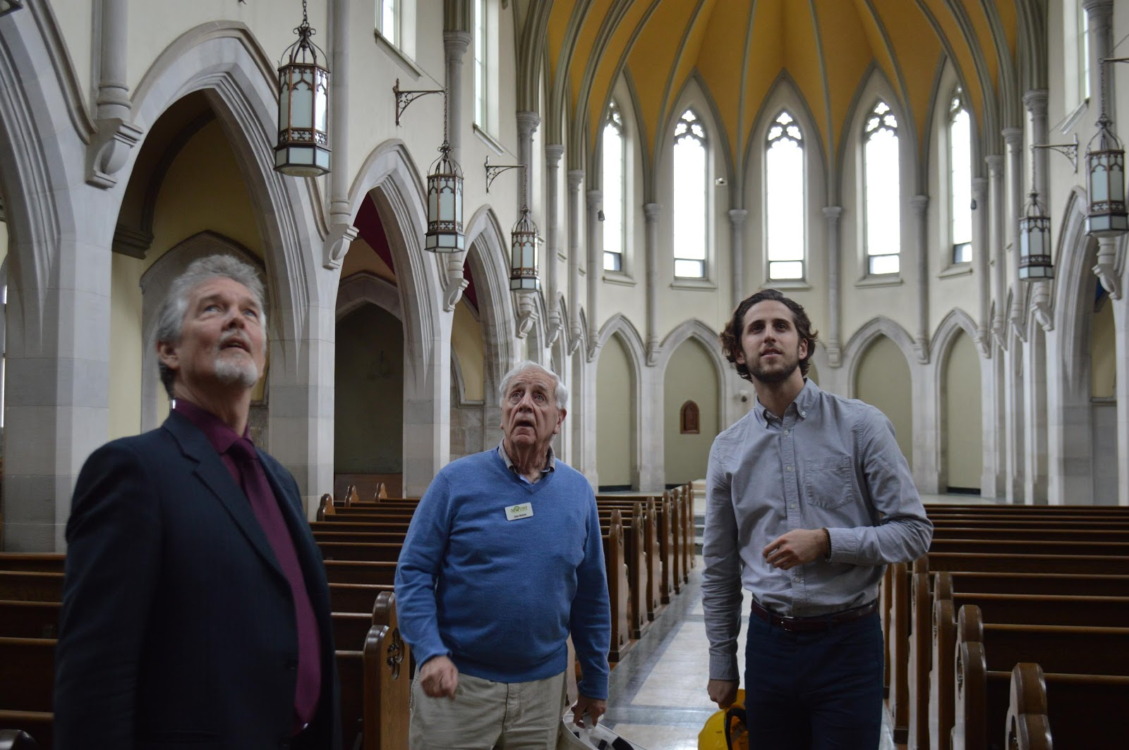
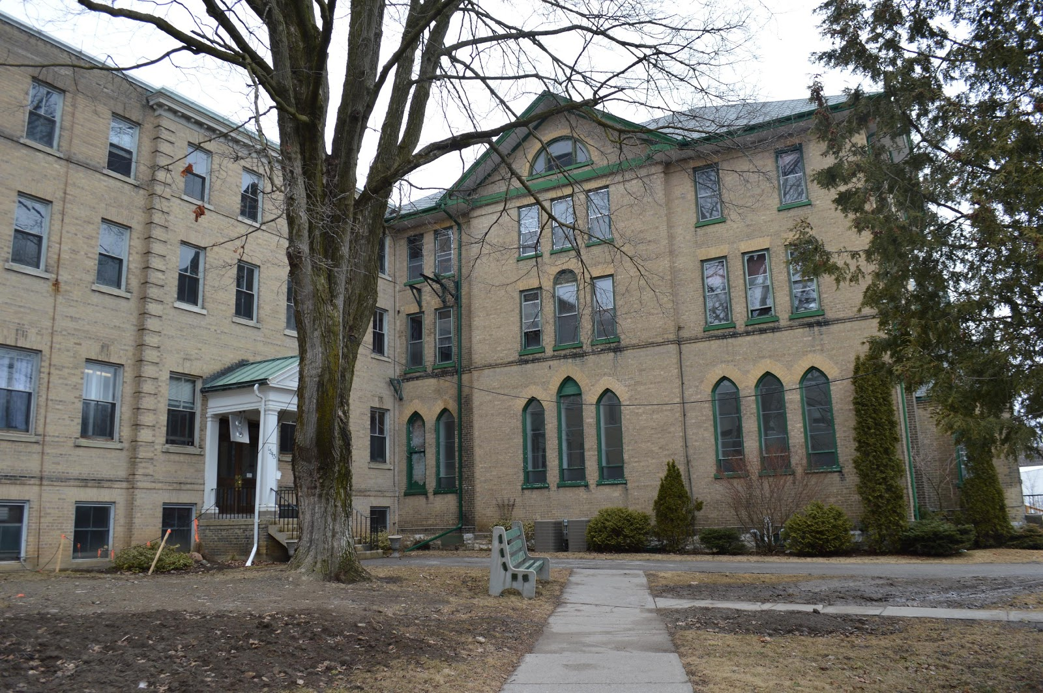

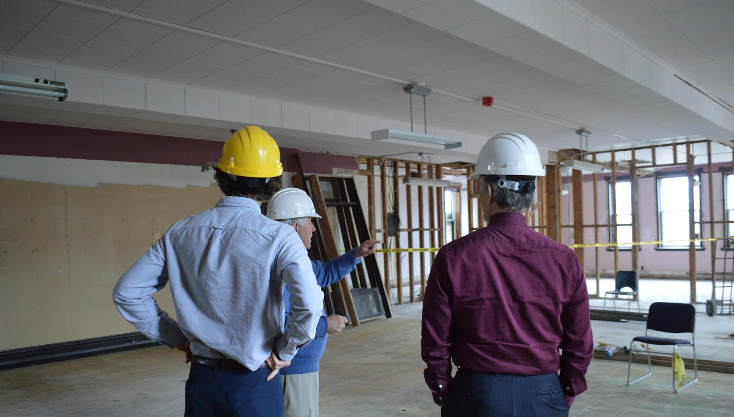

Slide 4

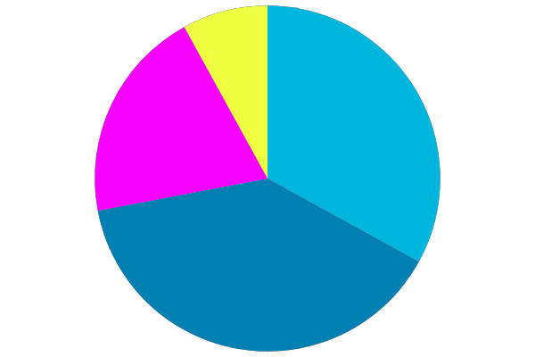
IN KIND
LOANS
GRANTS
COMMUNITY BONDS
Project Cost: $5 million
Bond total: $2 million
Timeline: 6 months

Slide 5
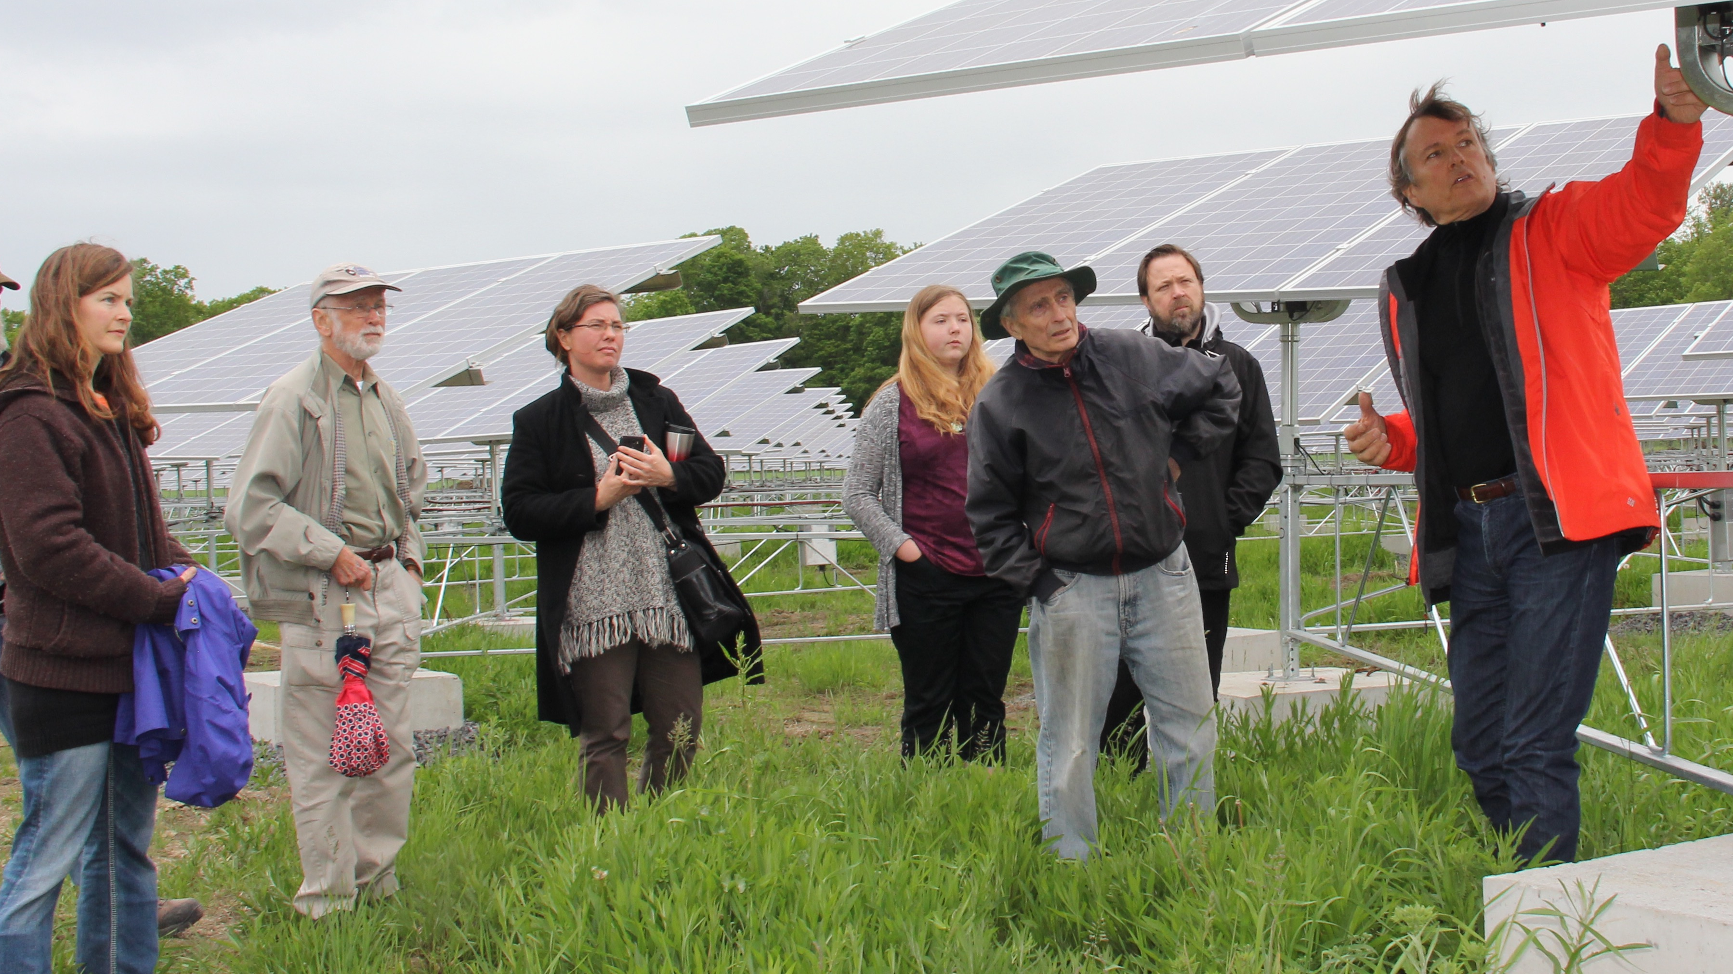
Let’s Finance with the Power of Community
20 years of experience raising community financing for environmental and social projects.
We have supported 7 issuers across 13 campaigns, raising $55 million in community investment.
Currently support over 3,800 community investors on our platform.
Notes:
Brief history of our experience in raising community financing for renewable energy projects
Tapestry is a new social venture, with a backing of 20 years of experience

Slide 6
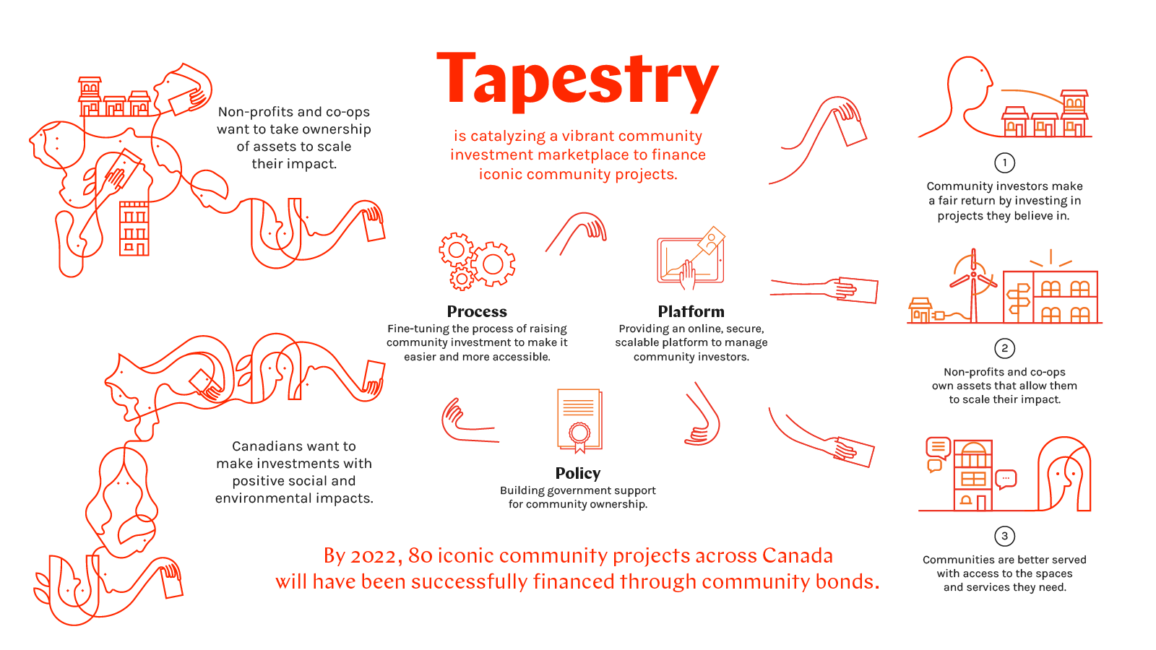

Slide 7
Thank You!
You are the Founding Thread in Our Tapestry
Finance to the Power of Community
www.tapestrycapital.ca

